Slide 1

Data

Slide 2
UNI ROUTES
Software Name

Slide 3
Abdallah Basem Zain 22100848 Ahmed Islam Abbas 22101008 Belal Fathy Abdelfatah 22101311 Mazen Ahmed Samir 22100369 Eyad Metwally Elnakib 22100757 Mahmoud Eid Khamis 22100680
Team

Slide 4
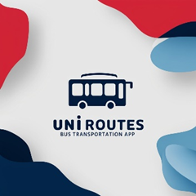
Initial Logo

Slide 5
Introduction

Slide 6
1. Coordinator Identification
We identified key coordinators, including:
Students: Representing most user, their perspectives on schedules routes and affordability were critical.

Slide 7

Transportation Admins: Responsible for planning and executing the transport services.
University Admins: Overseeing budgeting policymaking and sustainability goals
1. Coordinator Identification
We identified key coordinators, including:
Students: Representing most user, their perspectives on schedules routes and affordability were critical.

Slide 8

Transportation Admins: Responsible for planning and executing the transport services.
University Admins: Overseeing budgeting policymaking and sustainability goals
1. Coordinator Identification
We identified key coordinators, including:
Students: Representing most user, their perspectives on schedules routes and affordability were critical.
2. Interview Planning
Structured interviews were chosen as the primary method to explore coordinators needs.

Slide 9

Transportation Admins: Responsible for planning and executing the transport services.
University Admins: Overseeing budgeting policymaking and sustainability goals
1. Coordinator Identification
We identified key coordinators, including:
Students: Representing most user, their perspectives on schedules routes and affordability were critical.
3-Surveys and forms
A Form for students is an essential step in gathering their feedback, preferences, and needs for the UniRoutes transportation system. This form will help ensure that the system is designed to address the actual concerns and priorities of its primary users
2. Interview Planning
Structured interviews were chosen as the primary method to explore coordinators needs.

Slide 10



Current Handling of Transportation Challenges
Question to Ask:
Purpose
Admin Responses
How do you currently manage transportation schedules, routes, and demand?
What tools or systems (if any) do you use for tracking buses and handling user feedback?
How do you allocate resources like buses and drivers?
Identify gaps or inefficiencies in the current system that the app could address
We use manual scheduling, which is time-consuming.
There’s no way to monitor bus locations in real time.
Allocating buses to routes is mostly based on guesswork without solid data.

Slide 11
Current Handling of Transportation Challenges
Question to Ask:
How do you currently manage transportation schedules, routes, and demand?
What tools or systems (if any) do you use for tracking buses and handling user feedback?
How do you allocate resources like buses and drivers?
Purpose
Admin Responses
Identify gaps or inefficiencies in the current system that the app could address
We use manual scheduling, which is time-consuming.
There’s no way to monitor bus locations in real time.
Allocating buses to routes is mostly based on guesswork without solid data.

Slide 12
Current Handling of Transportation Challenges
Question to Ask:
Purpose
How do you currently manage transportation schedules, routes, and demand?
What tools or systems (if any) do you use for tracking buses and handling user feedback?
How do you allocate resources like buses and drivers?
Identify gaps or inefficiencies in the current system that the app could address
Admin Responses
We use manual scheduling, which is time-consuming.
There’s no way to monitor bus locations in real time.
Allocating buses to routes is mostly based on guesswork without solid data.

Slide 13
Current Handling of Transportation Challenges
Question to Ask:
Purpose
Admin Responses
How do you currently manage transportation schedules, routes, and demand?
What tools or systems (if any) do you use for tracking buses and handling user feedback?
How do you allocate resources like buses and drivers?
Identify gaps or inefficiencies in the current system that the app could address
We use manual scheduling, which is time-consuming.
There’s no way to monitor bus locations in real time.
Allocating buses to routes is mostly based on guesswork without solid data.

Slide 14
Features for the App
Question to Ask:
Purpose
Admin Responses
How do you currently manage transportation schedules, routes, and demand?
What tools or systems (if any) do you use for tracking buses and handling user feedback?
How do you allocate resources like buses and drivers?
Identify gaps or inefficiencies in the current system that the app could address
We use manual scheduling, which is time-consuming.
There’s no way to monitor bus locations in real time.
Allocating buses to routes is mostly based on guesswork without solid data.

Slide 15
Features for the App
Question to Ask:
What specific features would make the app useful for your team?
Would you prefer real-time tracking for buses and drivers?
How important is user feedback integration into the app?
Purpose
Admin Responses
Identify gaps or inefficiencies in the current system that the app could address
We use manual scheduling, which is time-consuming.
There’s no way to monitor bus locations in real time.
Allocating buses to routes is mostly based on guesswork without solid data.

Slide 16
Features for the App
Question to Ask:
Purpose
What specific features would make the app useful for your team?
Would you prefer real-time tracking for buses and drivers?
How important is user feedback integration into the app?
Gather a wish list of features that solve specific pain points.
Admin Responses
We use manual scheduling, which is time-consuming.
There’s no way to monitor bus locations in real time.
Allocating buses to routes is mostly based on guesswork without solid data.

Slide 17
Features for the App
Question to Ask:
Admin Responses
Purpose
A dashboard for route optimization and scheduling.
Real-time tracking for buses and dynamic rerouting.
Automated resource allocation based on demand patterns.
A feedback system linked to individual routes or drivers
What specific features would make the app useful for your team?
Would you prefer real-time tracking for buses and drivers?
How important is user feedback integration into the app?
Gather a wish list of features that solve specific pain points.

Slide 18
Overcrowding and Underutilization Management
Question to Ask:
Purpose
Admin Responses
How do you currently manage transportation schedules, routes, and demand?
What tools or systems (if any) do you use for tracking buses and handling user feedback?
How do you allocate resources like buses and drivers?
Identify gaps or inefficiencies in the current system that the app could address
We use manual scheduling, which is time-consuming.
There’s no way to monitor bus locations in real time.
Allocating buses to routes is mostly based on guesswork without solid data.

Slide 19
Overcrowding and Underutilization Management
Question to Ask:
How do you currently handle overcrowded buses or underused routes?
Would you want the app to predict and address these issues dynamically?
Purpose
Admin Responses
Identify gaps or inefficiencies in the current system that the app could address
We use manual scheduling, which is time-consuming.
There’s no way to monitor bus locations in real time.
Allocating buses to routes is mostly based on guesswork without solid data.

Slide 20
Overcrowding and Underutilization Management
Question to Ask:
Purpose
How do you currently handle overcrowded buses or underused routes?
Would you want the app to predict and address these issues dynamically?
Understand if they need predictive analytics or on-the-spot solutions.
Admin Responses
We use manual scheduling, which is time-consuming.
There’s no way to monitor bus locations in real time.
Allocating buses to routes is mostly based on guesswork without solid data.

Slide 21
Overcrowding and Underutilization Management
Question to Ask:
Purpose
Admin Responses
How do you currently handle overcrowded buses or underused routes?
Would you want the app to predict and address these issues dynamically?
Understand if they need predictive analytics or on-the-spot solutions.
We currently rotate buses manually, which isn’t always effective.
An app that shows real-time usage could help us plan better.

Slide 22
Accessibility and Inclusivity
Question to Ask:
Purpose
Admin Responses
How do you currently manage transportation schedules, routes, and demand?
What tools or systems (if any) do you use for tracking buses and handling user feedback?
How do you allocate resources like buses and drivers?
Identify gaps or inefficiencies in the current system that the app could address
We use manual scheduling, which is time-consuming.
There’s no way to monitor bus locations in real time.
Allocating buses to routes is mostly based on guesswork without solid data.

Slide 23
Accessibility and Inclusivity
Question to Ask:
How do you ensure the transportation system is accessible to all users?
Would you like features to track accessibility metrics (e.g., wheelchair spaces used)?
Purpose
Admin Responses
Identify gaps or inefficiencies in the current system that the app could address
We use manual scheduling, which is time-consuming.
There’s no way to monitor bus locations in real time.
Allocating buses to routes is mostly based on guesswork without solid data.

Slide 24
Accessibility and Inclusivity
Question to Ask:
Purpose
How do you ensure the transportation system is accessible to all users?
Would you like features to track accessibility metrics (e.g., wheelchair spaces used)?
Determine if accessibility is a priority and identify specific needs.
Admin Responses
We use manual scheduling, which is time-consuming.
There’s no way to monitor bus locations in real time.
Allocating buses to routes is mostly based on guesswork without solid data.

Slide 25
Accessibility and Inclusivity
Question to Ask:
Purpose
Admin Responses
How do you ensure the transportation system is accessible to all users?
Would you like features to track accessibility metrics (e.g., wheelchair spaces used)?
Determine if accessibility is a priority and identify specific needs.
We don’t have a good way to measure accessibility usage currently.
Features to ensure equal access across routes would be valuable.

Slide 26
Data Monitoring and Usage Patterns
Question to Ask:
Purpose
Admin Responses
How do you currently manage transportation schedules, routes, and demand?
What tools or systems (if any) do you use for tracking buses and handling user feedback?
How do you allocate resources like buses and drivers?
Identify gaps or inefficiencies in the current system that the app could address
We use manual scheduling, which is time-consuming.
There’s no way to monitor bus locations in real time.
Allocating buses to routes is mostly based on guesswork without solid data.

Slide 27
Data Monitoring and Usage Patterns
Question to Ask:
Do you currently collect data on transportation usage?
What kind of reports or insights would you find most useful?
Purpose
Admin Responses
Identify gaps or inefficiencies in the current system that the app could address
We use manual scheduling, which is time-consuming.
There’s no way to monitor bus locations in real time.
Allocating buses to routes is mostly based on guesswork without solid data.

Slide 28
Data Monitoring and Usage Patterns
Question to Ask:
Purpose
Do you currently collect data on transportation usage?
What kind of reports or insights would you find most useful?
Understand their need for analytics and reporting features.
Admin Responses
We use manual scheduling, which is time-consuming.
There’s no way to monitor bus locations in real time.
Allocating buses to routes is mostly based on guesswork without solid data.

Slide 29
Data Monitoring and Usage Patterns
Question to Ask:
Purpose
Admin Responses
Do you currently collect data on transportation usage?
What kind of reports or insights would you find most useful?
Understand their need for analytics and reporting features.
We need data on peak usage times and underused routes to optimize the system.
Monthly reports on efficiency and feedback trends would be helpful.

Slide 30
Real-Time Tracking and Alerts
Question to Ask:
Purpose
Admin Responses
How do you currently manage transportation schedules, routes, and demand?
What tools or systems (if any) do you use for tracking buses and handling user feedback?
How do you allocate resources like buses and drivers?
Identify gaps or inefficiencies in the current system that the app could address
We use manual scheduling, which is time-consuming.
There’s no way to monitor bus locations in real time.
Allocating buses to routes is mostly based on guesswork without solid data.

Slide 31
Real-Time Tracking and Alerts
Question to Ask:
How do you currently notify users about delays or changes?
Would you like the app to provide live notifications or alerts?
Purpose
Admin Responses
Identify gaps or inefficiencies in the current system that the app could address
We use manual scheduling, which is time-consuming.
There’s no way to monitor bus locations in real time.
Allocating buses to routes is mostly based on guesswork without solid data.

Slide 32
Real-Time Tracking and Alerts
Question to Ask:
Purpose
How do you currently notify users about delays or changes?
Would you like the app to provide live notifications or alerts?
Gauge the importance of real-time communication features.
Admin Responses
We use manual scheduling, which is time-consuming.
There’s no way to monitor bus locations in real time.
Allocating buses to routes is mostly based on guesswork without solid data.

Slide 33
Real-Time Tracking and Alerts
Question to Ask:
Purpose
Admin Responses
How do you currently notify users about delays or changes?
Would you like the app to provide live notifications or alerts?
Gauge the importance of real-time communication features.
We use University Email notifications, but app-based alerts would be more effective.
Tracking features would reduce complaints about late buses.

Slide 34
Prioritization of Technological Upgrades
Question to Ask:
Purpose
Admin Responses
How do you currently manage transportation schedules, routes, and demand?
What tools or systems (if any) do you use for tracking buses and handling user feedback?
How do you allocate resources like buses and drivers?
Identify gaps or inefficiencies in the current system that the app could address
We use manual scheduling, which is time-consuming.
There’s no way to monitor bus locations in real time.
Allocating buses to routes is mostly based on guesswork without solid data.

Slide 35
Prioritization of Technological Upgrades
Question to Ask:
If resources were unlimited, what changes would you prioritize in your transportation system?
Are there specific technologies you’d like integrated
Purpose
Admin Responses
Identify gaps or inefficiencies in the current system that the app could address
We use manual scheduling, which is time-consuming.
There’s no way to monitor bus locations in real time.
Allocating buses to routes is mostly based on guesswork without solid data.

Slide 36
Prioritization of Technological Upgrades
Question to Ask:
Purpose
If resources were unlimited, what changes would you prioritize in your transportation system?
Are there specific technologies you’d like integrated
Highlight the admins' vision for modernization and align app features with their goals.
Admin Responses
We use manual scheduling, which is time-consuming.
There’s no way to monitor bus locations in real time.
Allocating buses to routes is mostly based on guesswork without solid data.

Slide 37
Prioritization of Technological Upgrades
Question to Ask:
Purpose
Admin Responses
If resources were unlimited, what changes would you prioritize in your transportation system?
Are there specific technologies you’d like integrated
Highlight the admins' vision for modernization and align app features with their goals.
AI-based demand prediction to allocate buses dynamically.

Slide 38
Long-Term Vision for the System
Question to Ask:
Purpose
Admin Responses
How do you currently manage transportation schedules, routes, and demand?
What tools or systems (if any) do you use for tracking buses and handling user feedback?
How do you allocate resources like buses and drivers?
Identify gaps or inefficiencies in the current system that the app could address
We use manual scheduling, which is time-consuming.
There’s no way to monitor bus locations in real time.
Allocating buses to routes is mostly based on guesswork without solid data.

Slide 39
Long-Term Vision for the System
Question to Ask:
How do you envision the transportation system evolving in the next 5–10 years?
How can this app support your long-term goals?
Purpose
Admin Responses
Identify gaps or inefficiencies in the current system that the app could address
We use manual scheduling, which is time-consuming.
There’s no way to monitor bus locations in real time.
Allocating buses to routes is mostly based on guesswork without solid data.

Slide 40
Long-Term Vision for the System
Question to Ask:
Purpose
How do you envision the transportation system evolving in the next 5–10 years?
How can this app support your long-term goals?
Align app development with their future plans for scalability and growth.
Admin Responses
We use manual scheduling, which is time-consuming.
There’s no way to monitor bus locations in real time.
Allocating buses to routes is mostly based on guesswork without solid data.

Slide 41
Long-Term Vision for the System
Question to Ask:
Purpose
Admin Responses
How do you envision the transportation system evolving in the next 5–10 years?
How can this app support your long-term goals?
Align app development with their future plans for scalability and growth.
We want a system that scales with our growing student population.
Integration with city transit systems is a long-term goal.

Slide 42
Other Considerations
Question to Ask:
Purpose
Admin Responses
How do you currently manage transportation schedules, routes, and demand?
What tools or systems (if any) do you use for tracking buses and handling user feedback?
How do you allocate resources like buses and drivers?
Identify gaps or inefficiencies in the current system that the app could address
We use manual scheduling, which is time-consuming.
There’s no way to monitor bus locations in real time.
Allocating buses to routes is mostly based on guesswork without solid data.

Slide 43
Other Considerations
Question to Ask:
Are there specific complaints or suggestions you frequently hear from users?
Is there anything we haven’t discussed that you feel is critical for the app?
Purpose
Admin Responses
Identify gaps or inefficiencies in the current system that the app could address
We use manual scheduling, which is time-consuming.
There’s no way to monitor bus locations in real time.
Allocating buses to routes is mostly based on guesswork without solid data.

Slide 44
Other Considerations
Question to Ask:
Purpose
Are there specific complaints or suggestions you frequently hear from users?
Is there anything we haven’t discussed that you feel is critical for the app?
Capture overlooked pain points or additional requirements.
Admin Responses
We use manual scheduling, which is time-consuming.
There’s no way to monitor bus locations in real time.
Allocating buses to routes is mostly based on guesswork without solid data.

Slide 45
Other Considerations
Question to Ask:
Purpose
Admin Responses
Are there specific complaints or suggestions you frequently hear from users?
Is there anything we haven’t discussed that you feel is critical for the app?
Capture overlooked pain points or additional requirements.
A common complaint is inaccurate schedules—real-time updates would help.
It’s important that the app has a simple and intuitive interface.

Slide 46
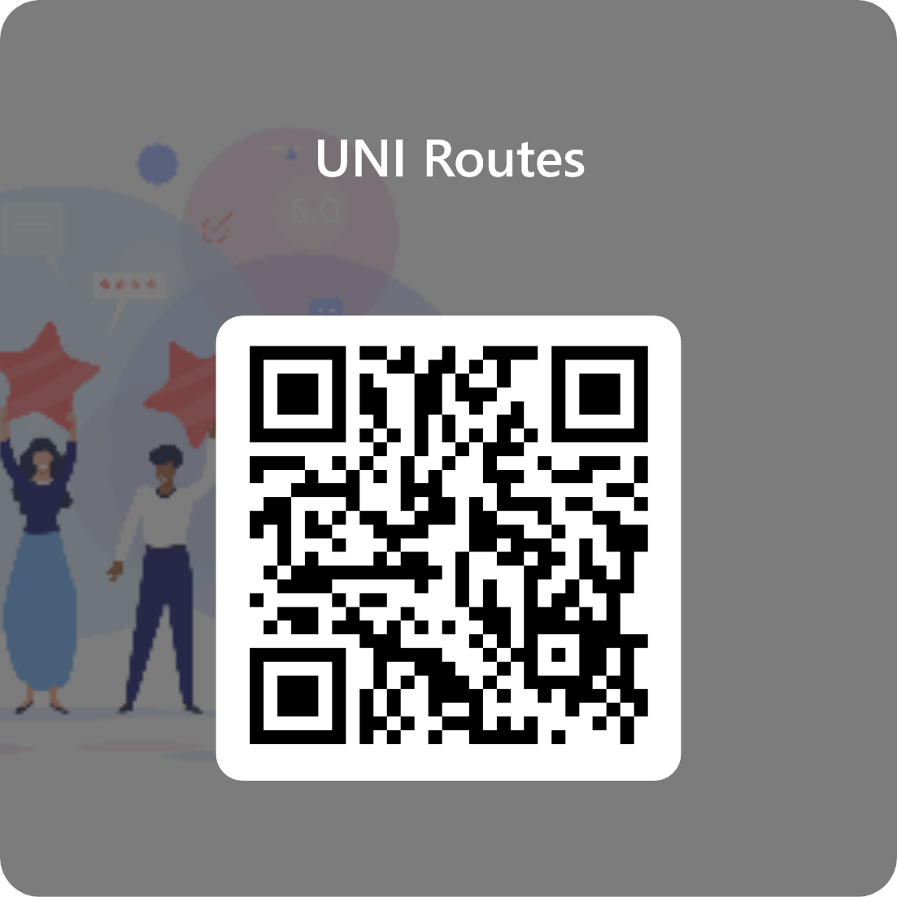
This is the form that was sent to the students to get their feedback
Form

Slide 47
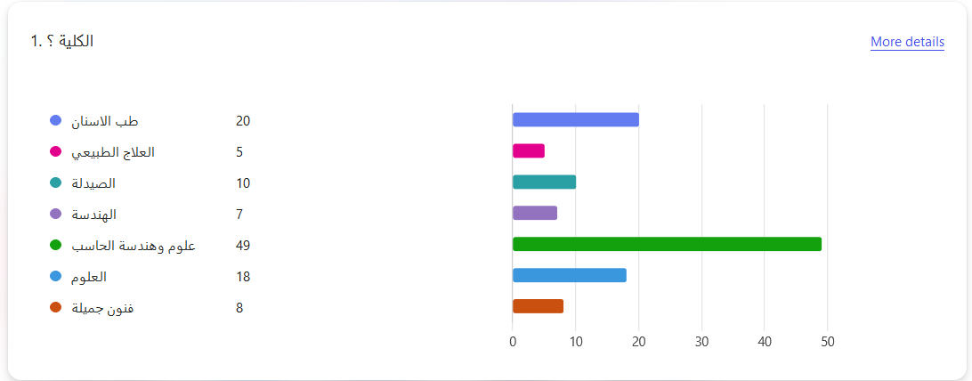
These were the results of our study
117 Students have responded to the survey and these are the results

Slide 48
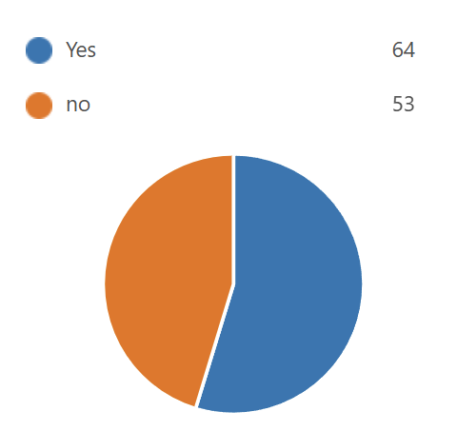
Subscription to the University Transfer Service
53% of respondents are subscribed to the service, while 47% are not.
Actionable Insight: Focus on understanding why some students are not subscribed and address their concerns to increase adoption.

Slide 49
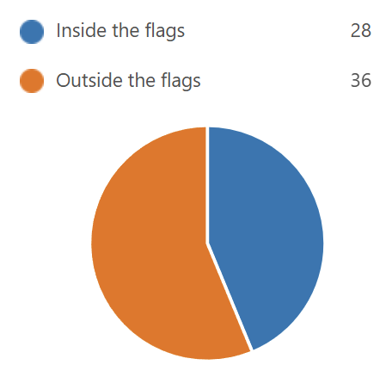
Subscription Type
40% of respondents have subscriptions Inside Alamein (shorter-distance services), while 60% are Outside the city (Longer-distance services).
Implication: Ensure that the service caters effectively to students who require transportation over longer distances, as they form the majority.

